Slide 1
Top 10 populated countries
CAPSTONE PROJECT
Presented By:
Santhana Karthick . U
9513- Jayaraj Annapackiam CSI College of Engineering
B.E Mechanical Engineering

Slide 2
OUTLINE
Problem Statement
Proposed System/Solution
System Development Approach
Algorithm & Deployment
Result
Conclusion
Future Scope
References

Slide 3
Problem Statement
You are given a dataset containing the populations of the top 10 most populated countries in the world. The data is structured as follows:
China - 1441
India - 1393
3. United States – 331
4. Indonesia - 273
Pakistan - 225
Your task is to write a program that can perform the following operations:
Display the top 10 countries sorted by population in descending order.Calculate and display the total population of all 10 countries combined.Calculate and display the average population of these 10 countries.Additionally, the program should be able to handle the addition of a new country and its population to the dataset. After adding the new country, the program should update the top 10 list accordingly and recalculate the total population and average population.
6. Brazil - 213
7. Nigeria – 211
8. Bangladesh – 165
9. Russia – 146
10. Mexico - 128

Slide 4
Proposed Solution
Population control may use one or more of the following practices although there are other methods as well:
contraception.
abstinence.
medical abortion.
emigration.
decreasing immigration.
sterilization.
euthanasia

Slide 5
System Approach
To create a system for managing the top 10 most populated countries along with their populations, we can follow a structured approach that involves defining the system's requirements, designing the architecture, implementing the functionality, and testing the system. Below is a system approach outline:
1. Requirements Gathering:
Define the functionalities the system should support (e.g., adding countries, displaying top 10, calculating total population, calculating average population).
Identify the input data format (e.g., country name, population in millions).
2. System Design:
Components:
Population Manager Class:
Methods to add countries, update the top 10 list, calculate total population, and calculate average population.
Data structures to store country-population pairs and the top 10 list.
3.Testing:
Test the system with different scenarios, such as adding countries in different orders, adding duplicate countries, and ensuring the calculations are accurate.
Verify that the system handles errors or edge cases gracefully, such as adding invalid data or trying to add more than 10 countries.

Slide 6
Algorithm & Deployment
Initialize Data Structures: Start by creating a data structure to store the countries and their populations. For efficient retrieval and updating of the top 10 list, consider using a priority queue or a sorted list.
Add Country Functionality: Implement a function to add a new country to the data structure. Upon adding a country, update the top 10 list if necessary.
Update Top 10 List: After adding a country, check if it belongs in the top 10 based on its population. If so, update the top 10 list accordingly.
Display Top 10: Implement a function to display the top 10 countries along with their populations. Ensure the list is sorted by population in descending order.
Calculate Total Population: Calculate the total population of the top 10 countries by summing their populations.
Calculate Average Population: Compute the average population of the top 10 countries by dividing the total population by 10 (or the actual number of countries if less than 10).
Error Handling: Include error handling for cases such as invalid input data or attempts to add duplicate countries.

Slide 7
deployment
Choose a Deployment Platform: Select a platform such as AWS, Azure, Google Cloud, or a self-hosted server where you'll deploy your application.
Containerization (Optional but Recommended): Containerize your application using Docker for easier deployment and management across different environments.
Set Up Environment: Configure the necessary environment settings such as Python version, dependencies (if any), and environment variables.
Deploy Application: Deploy your application to the chosen platform. This may involve uploading Docker containers, setting up server instances, configuring networking, and ensuring security measures.
Monitoring and Maintenance: Monitor your deployed application for performance, errors, and usage. Implement logging and monitoring solutions to track application health and user interactions. Regularly update and maintain your application to ensure optimal functionality and security.
Scaling (if needed): If your application experiences increased traffic or data volume, consider implementing auto-scaling capabilities to handle varying loads efficiently.

Slide 8
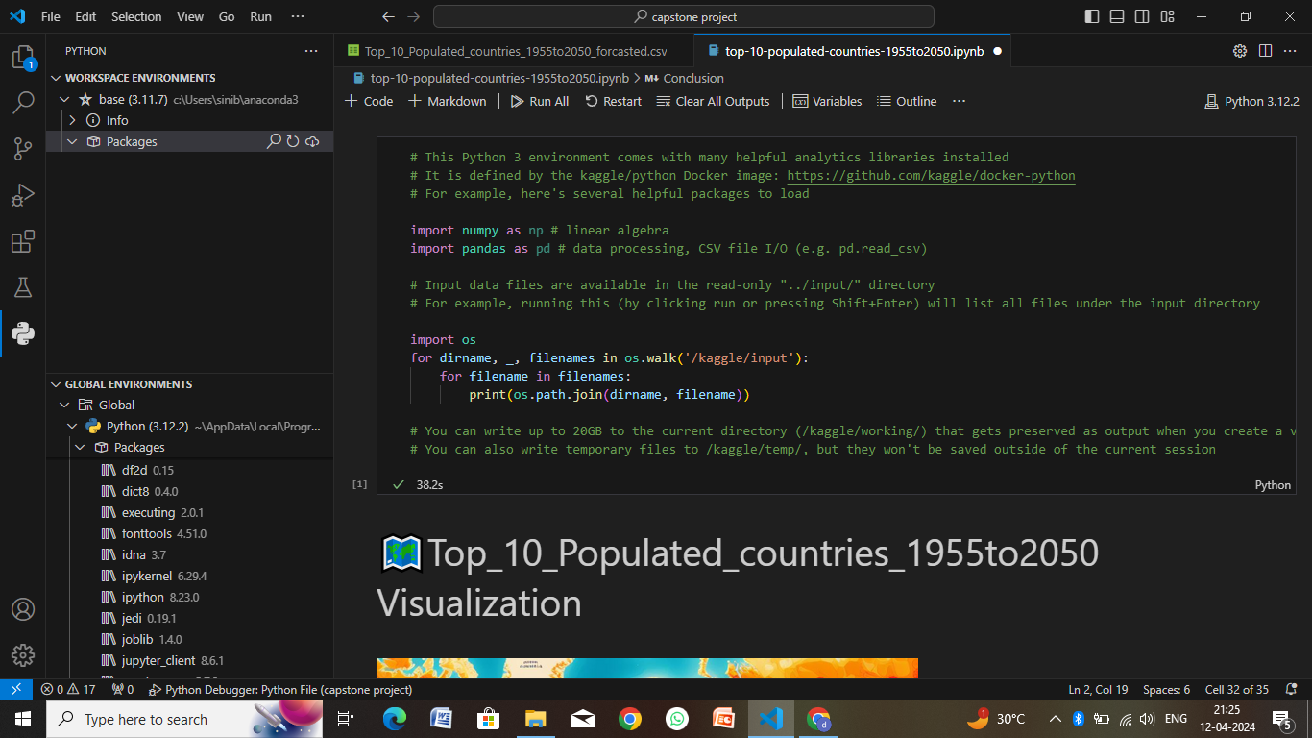
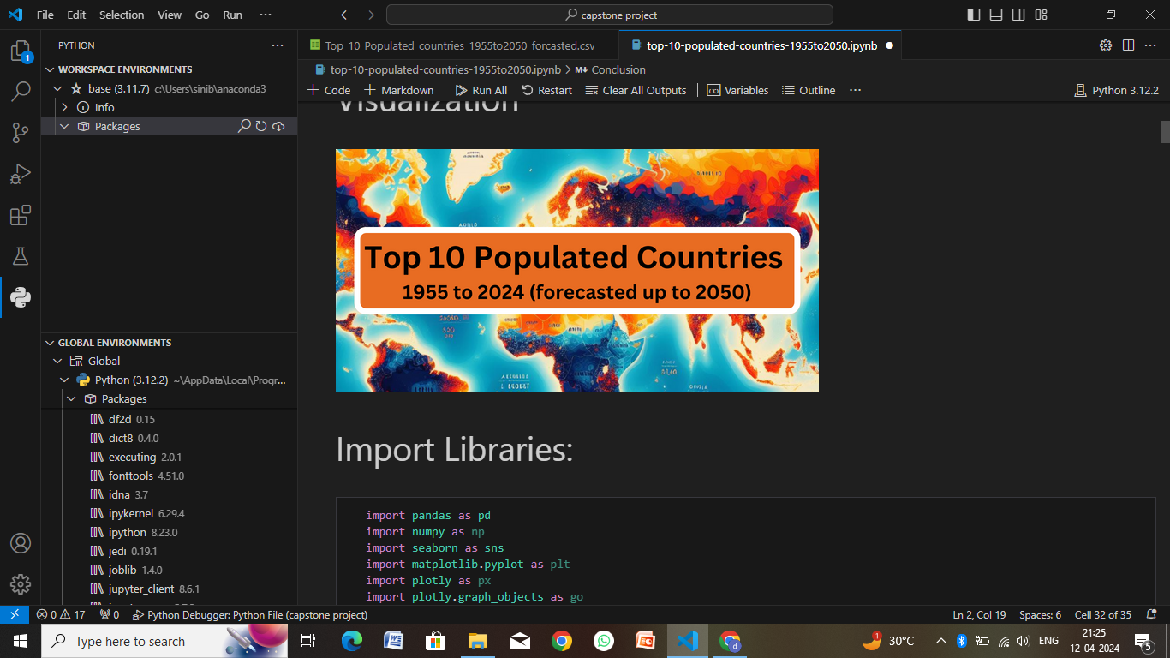
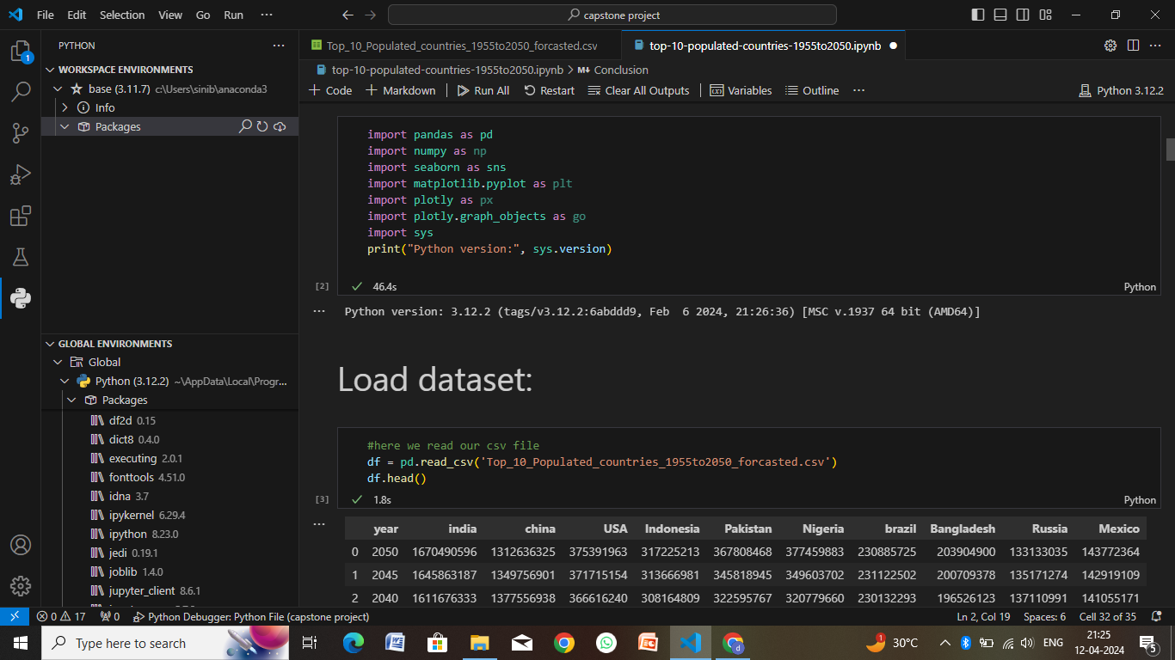
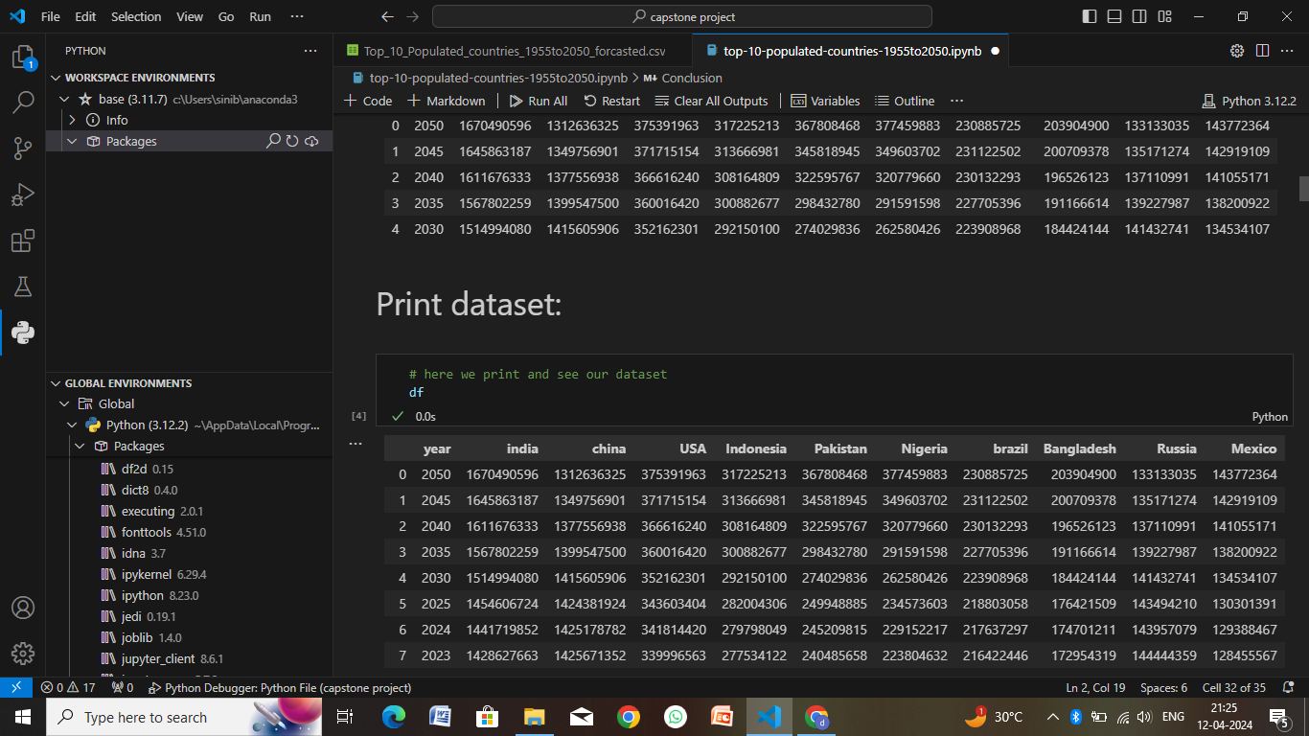
Result

Slide 9
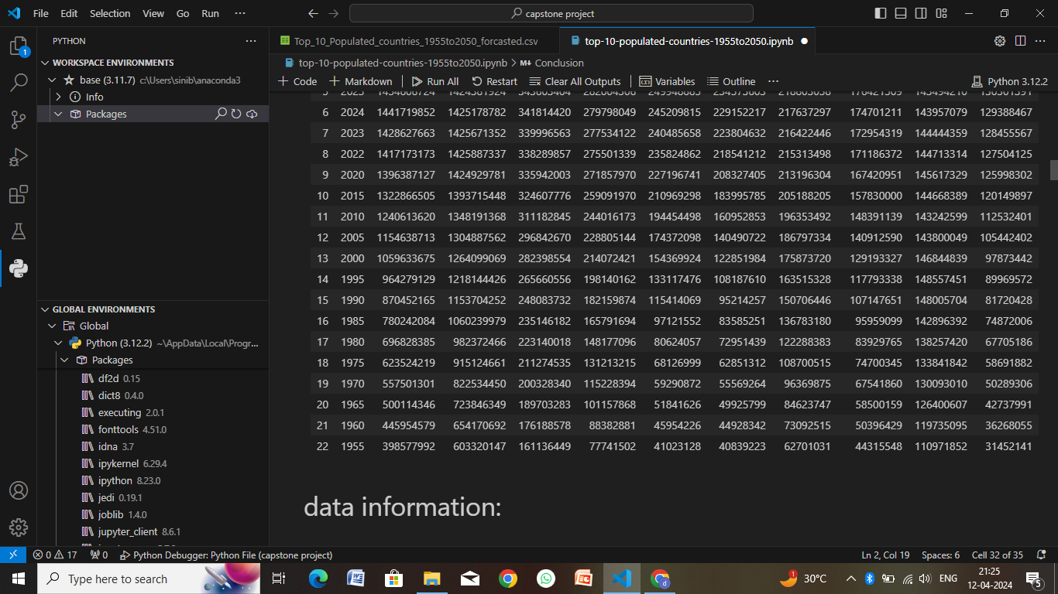
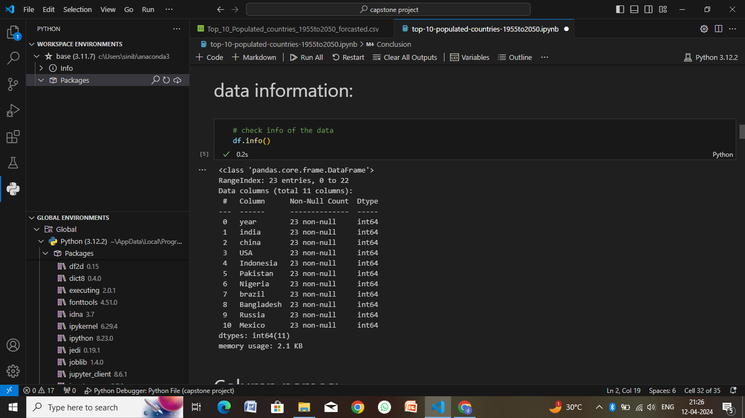
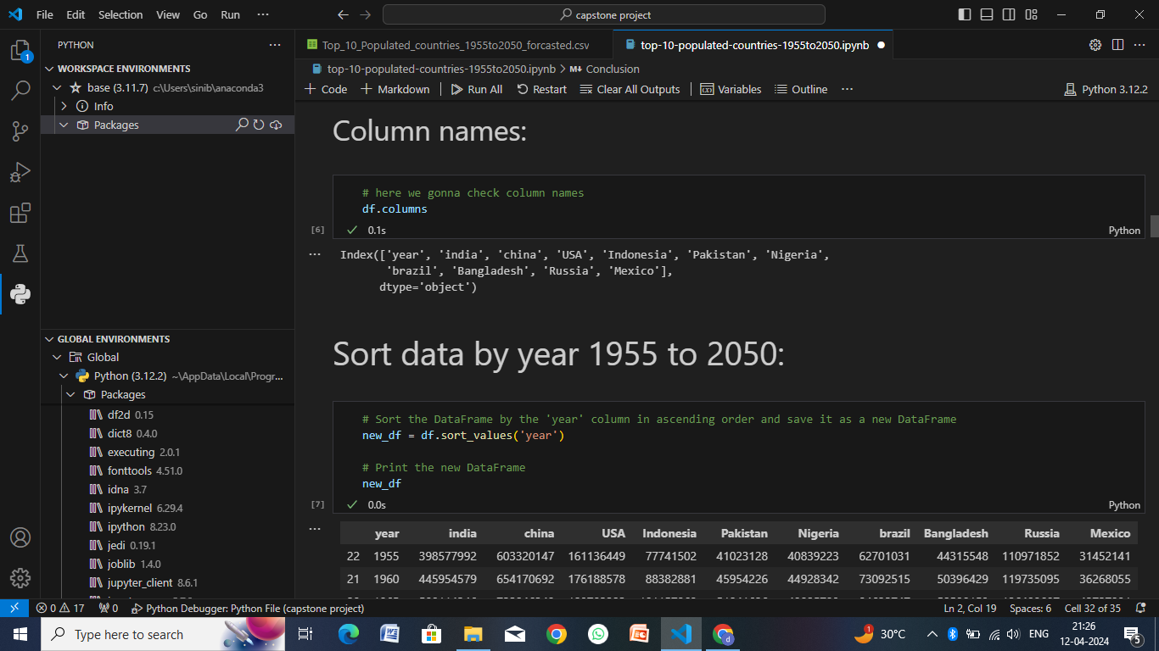
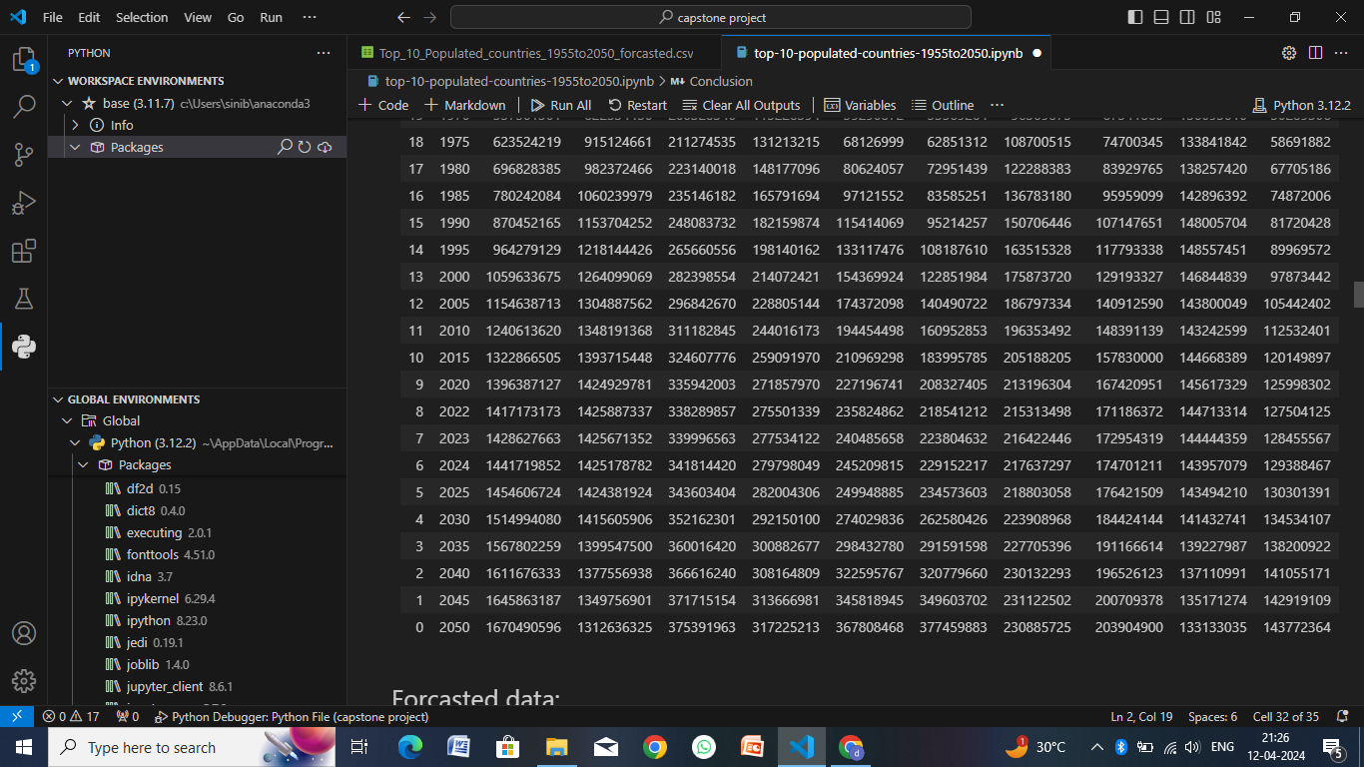

Slide 10
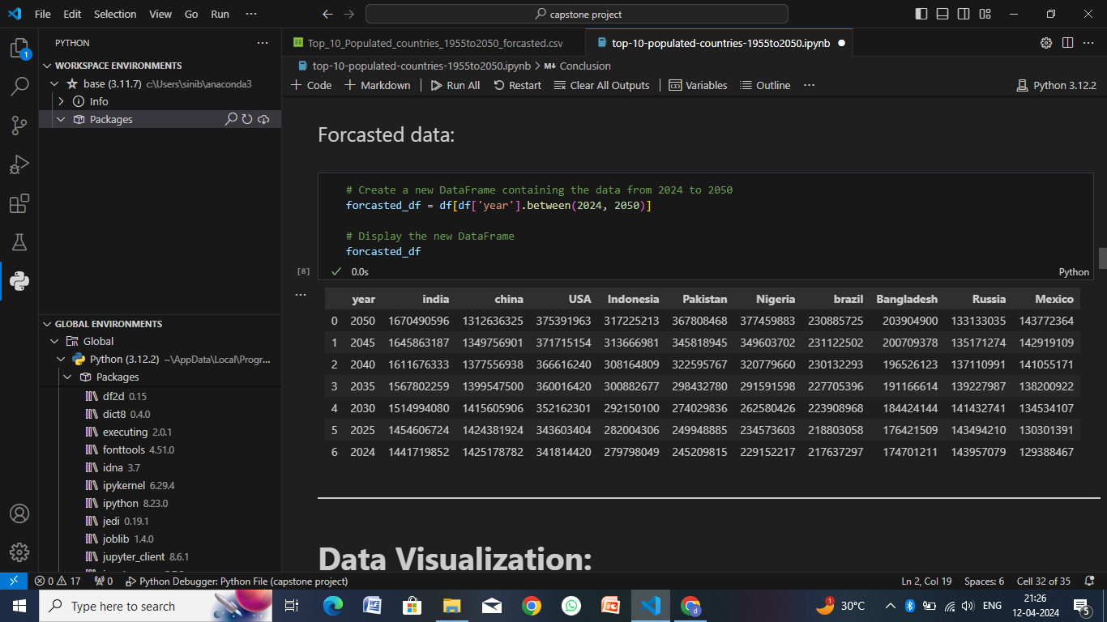
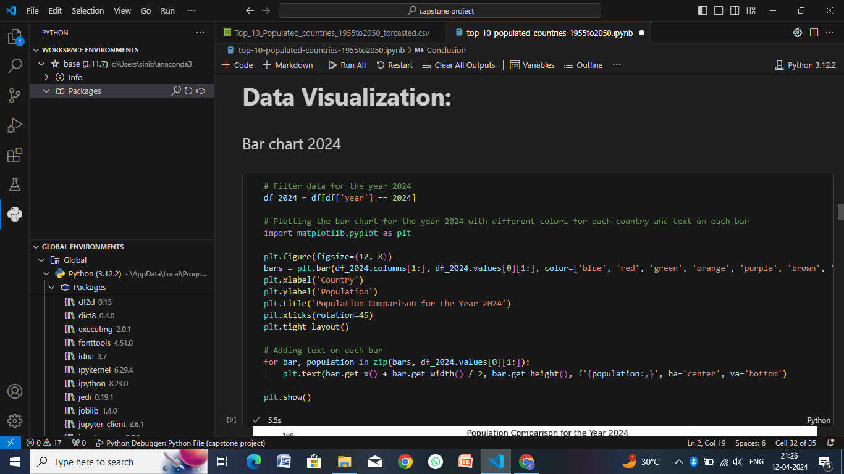
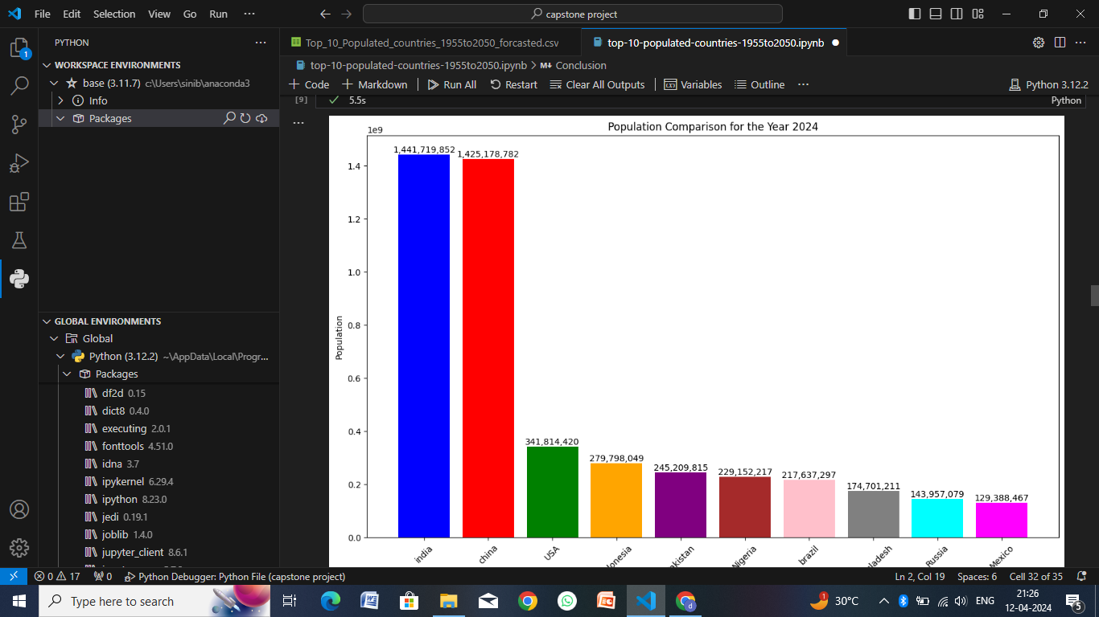
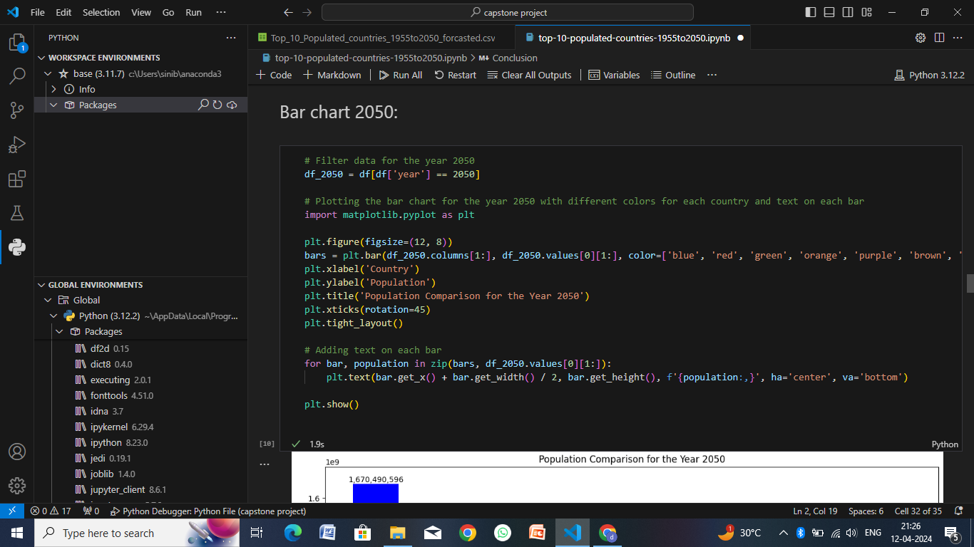

Slide 11
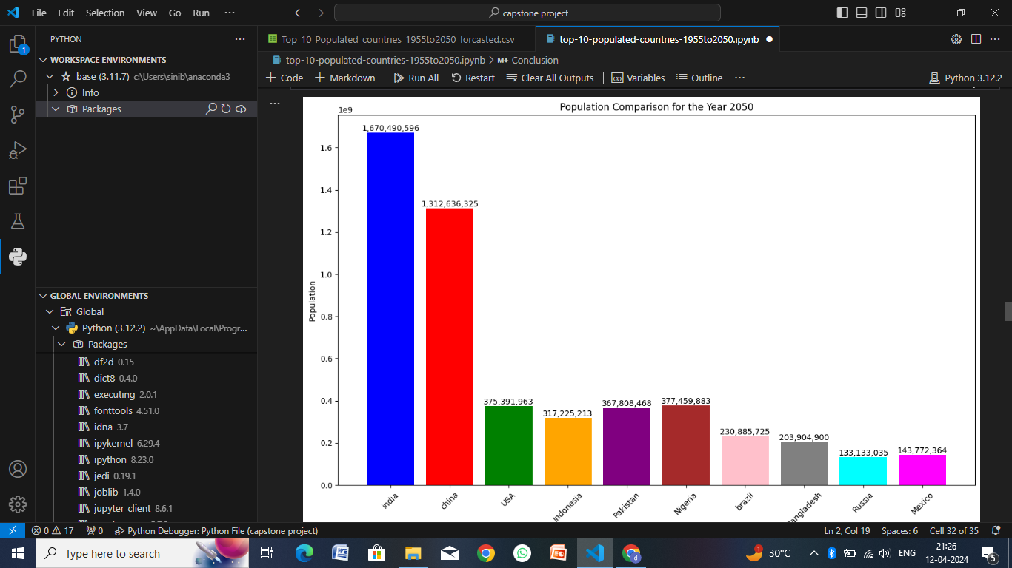
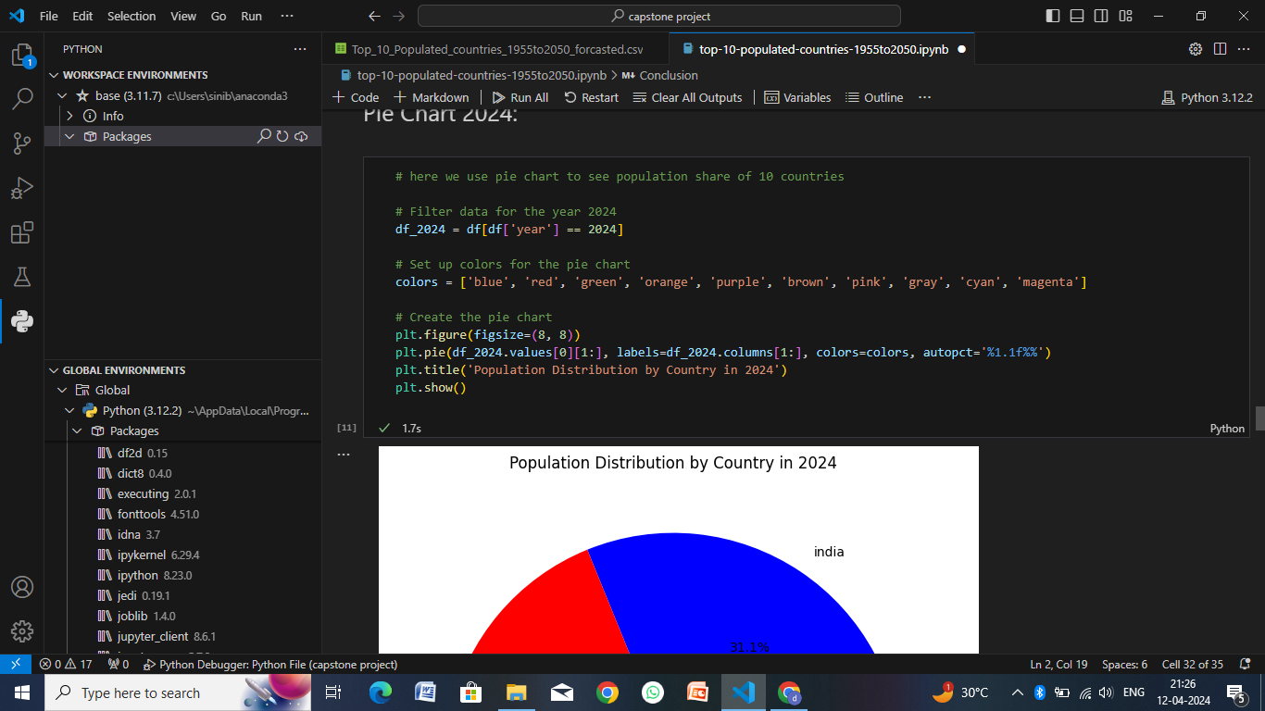
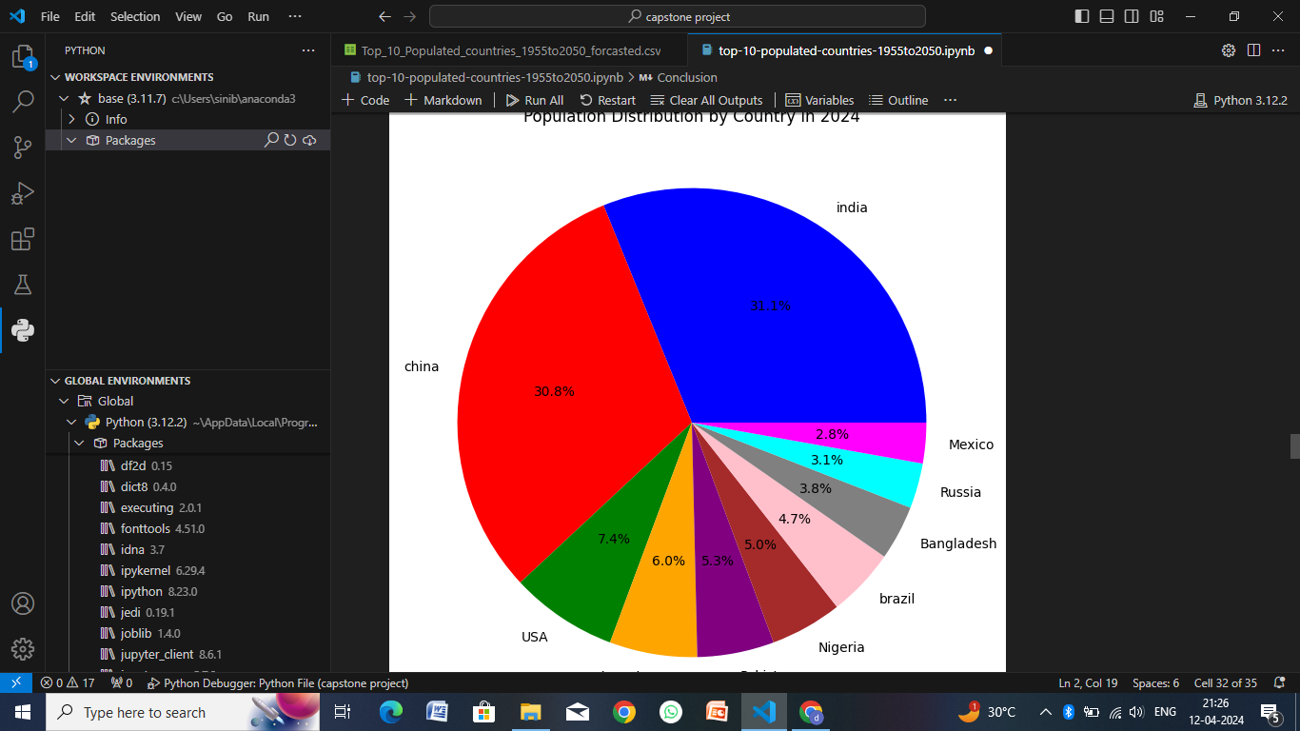
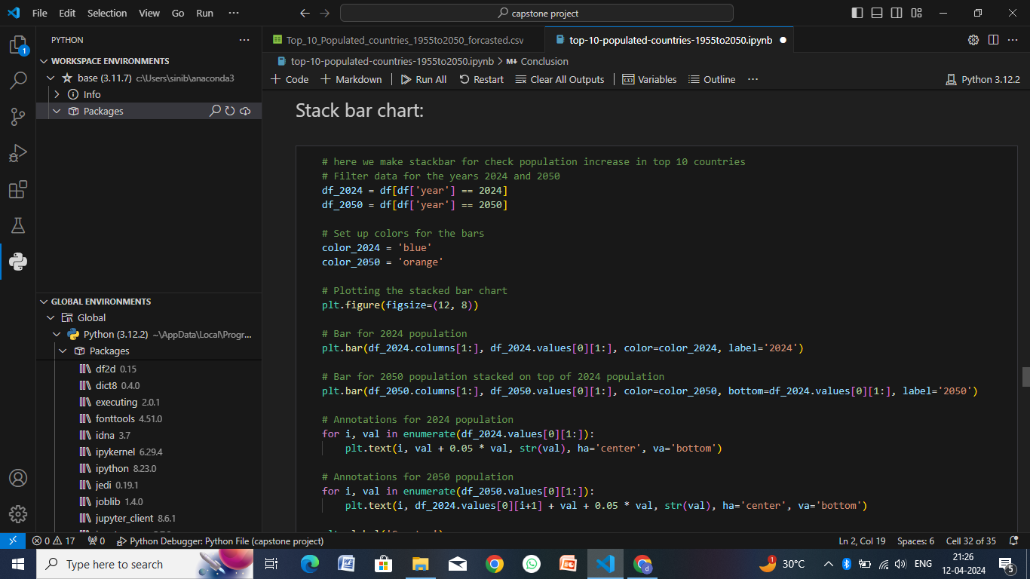

Slide 12
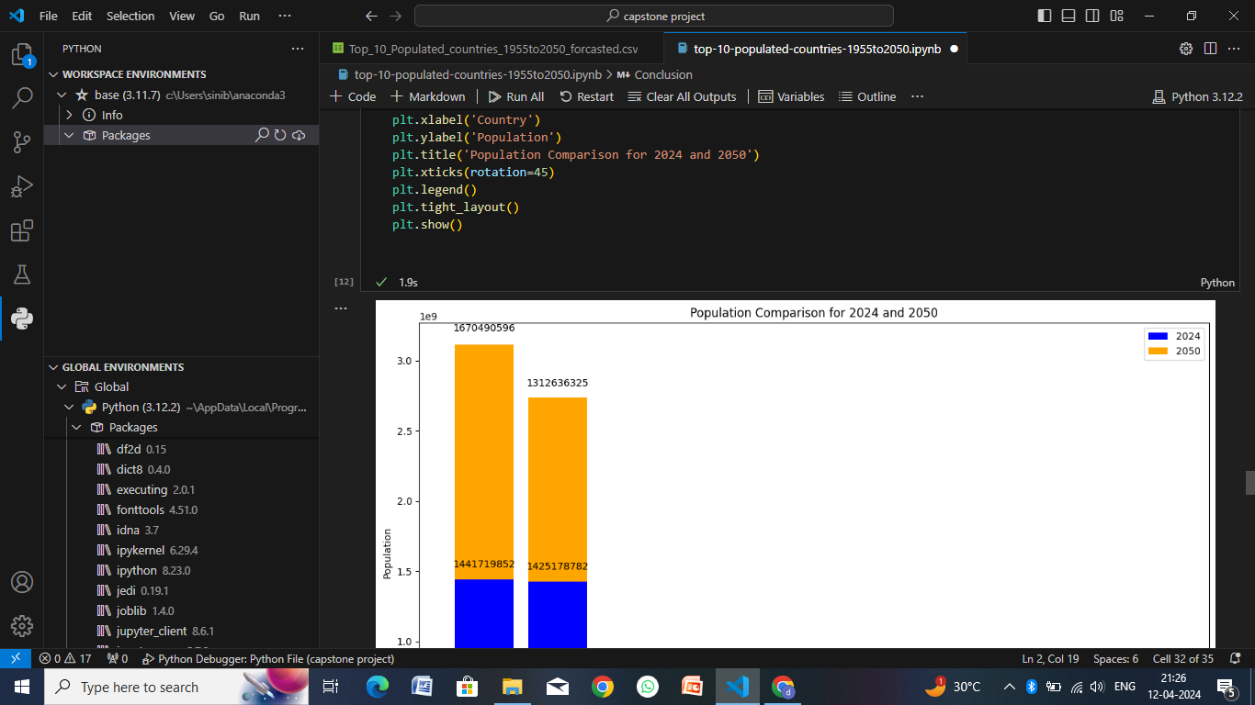
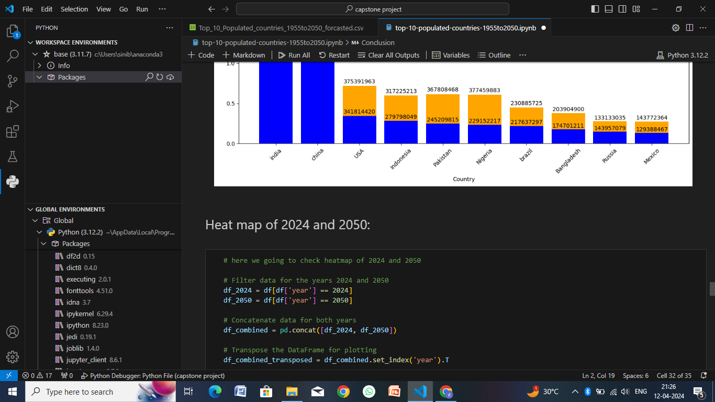
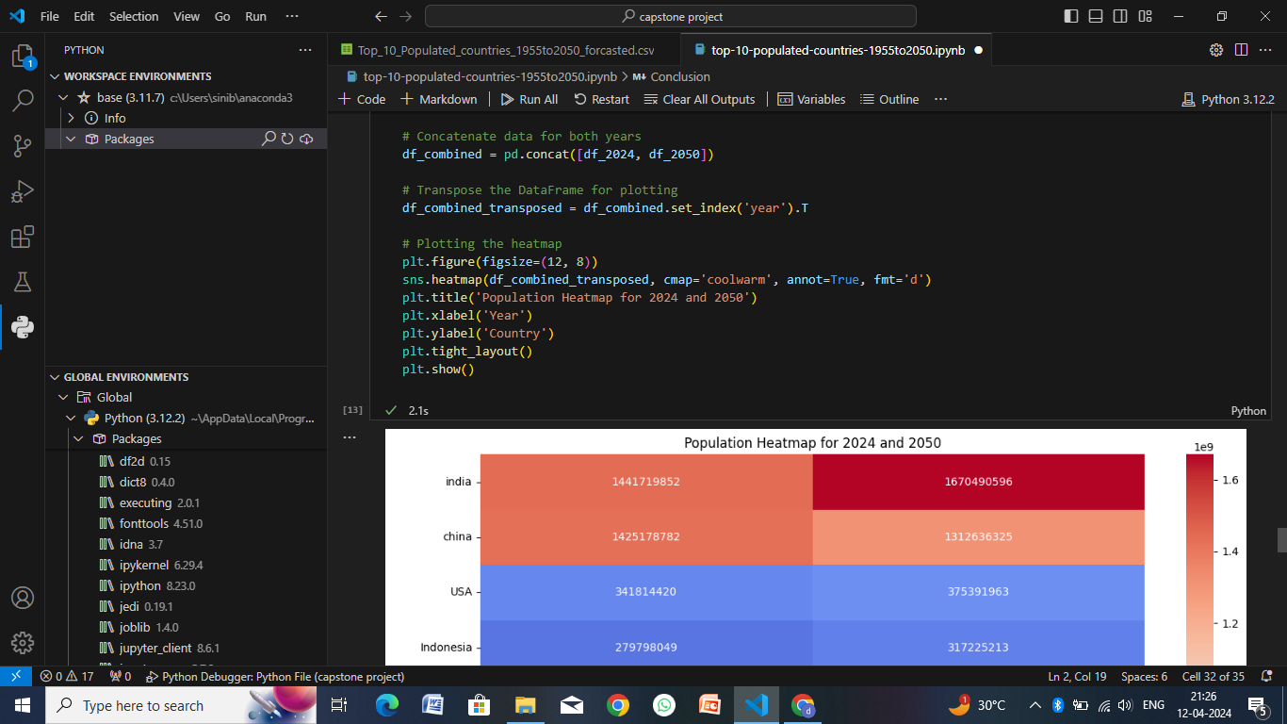
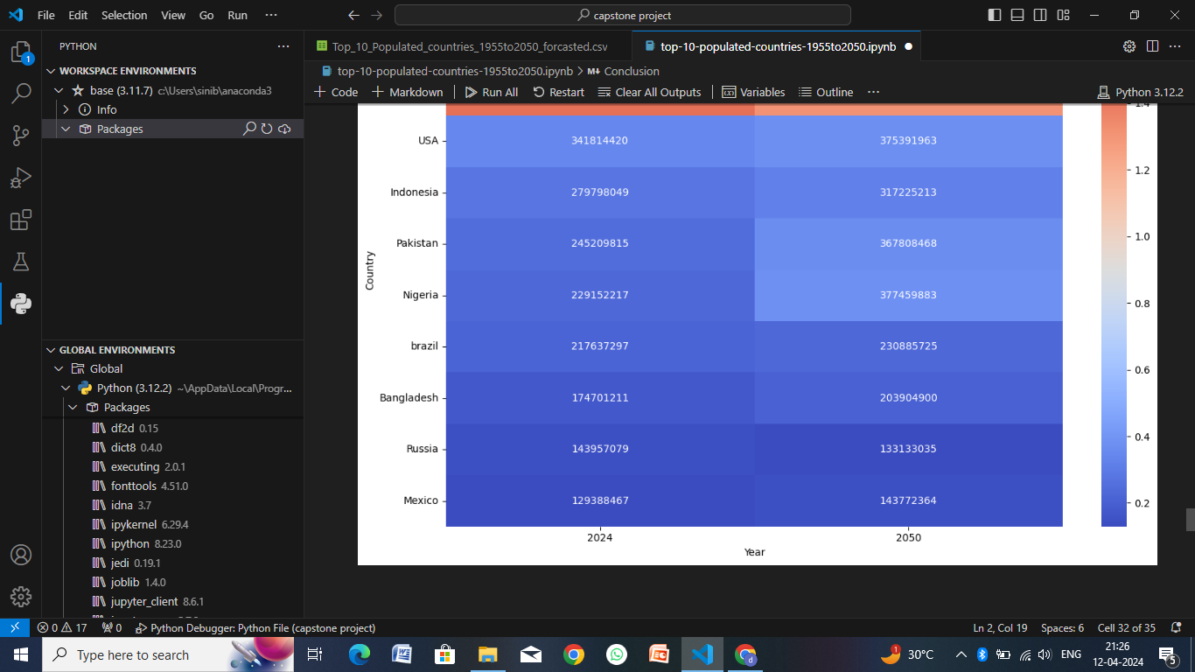

Slide 13
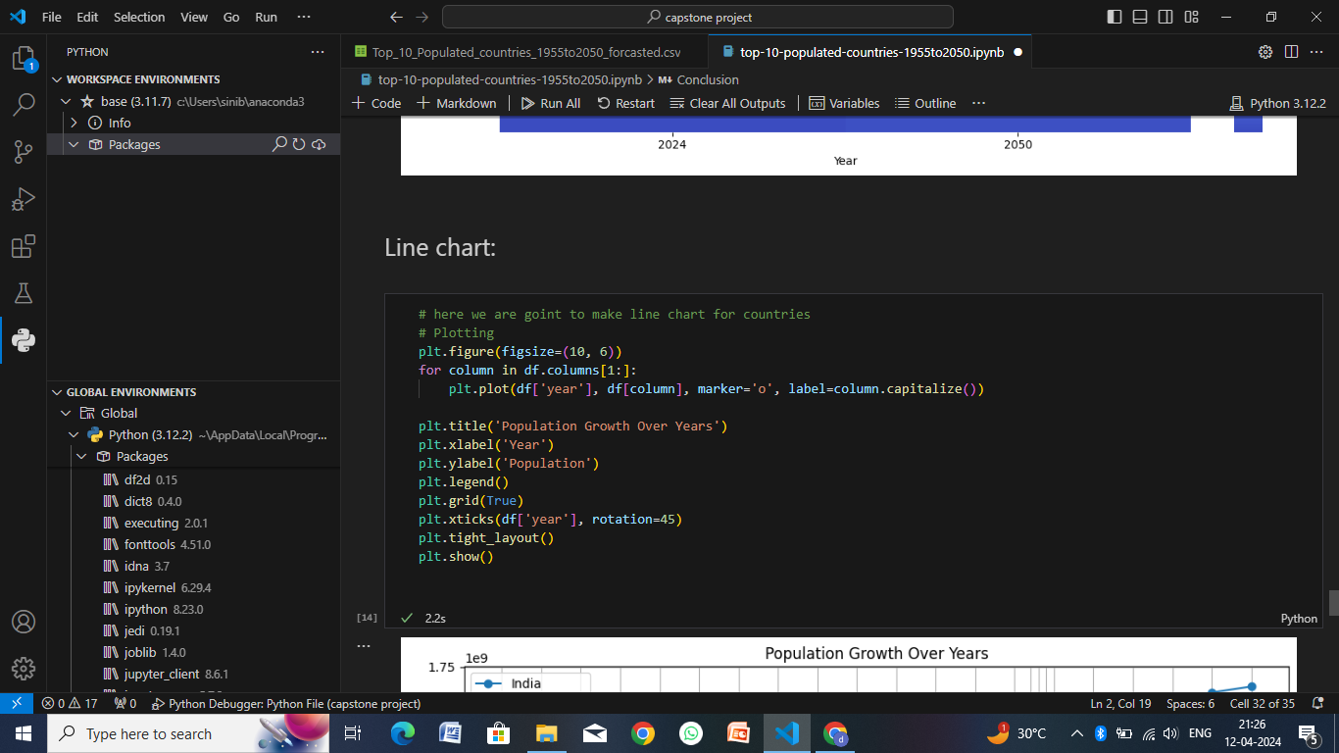
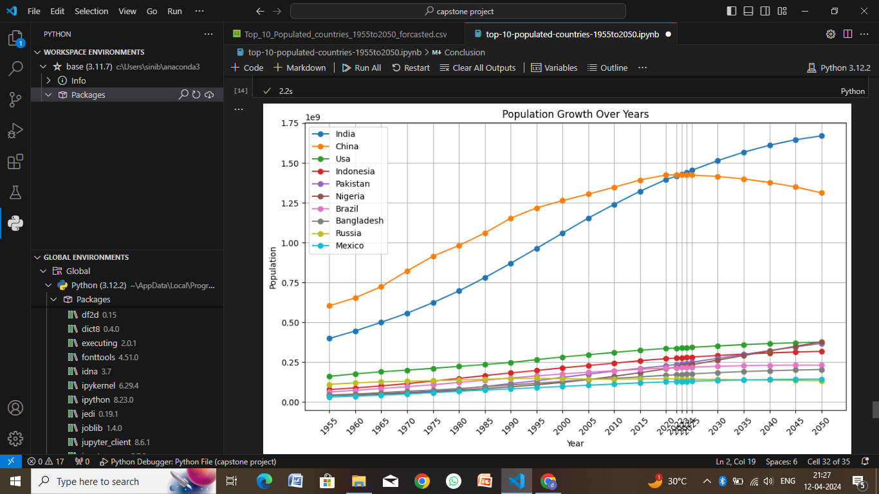
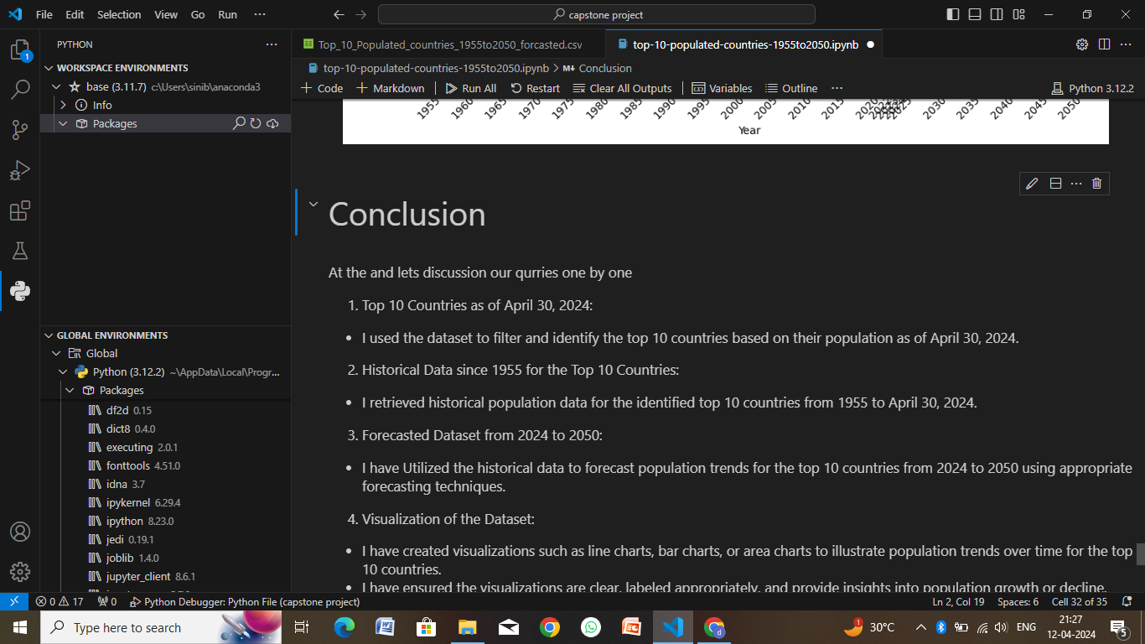
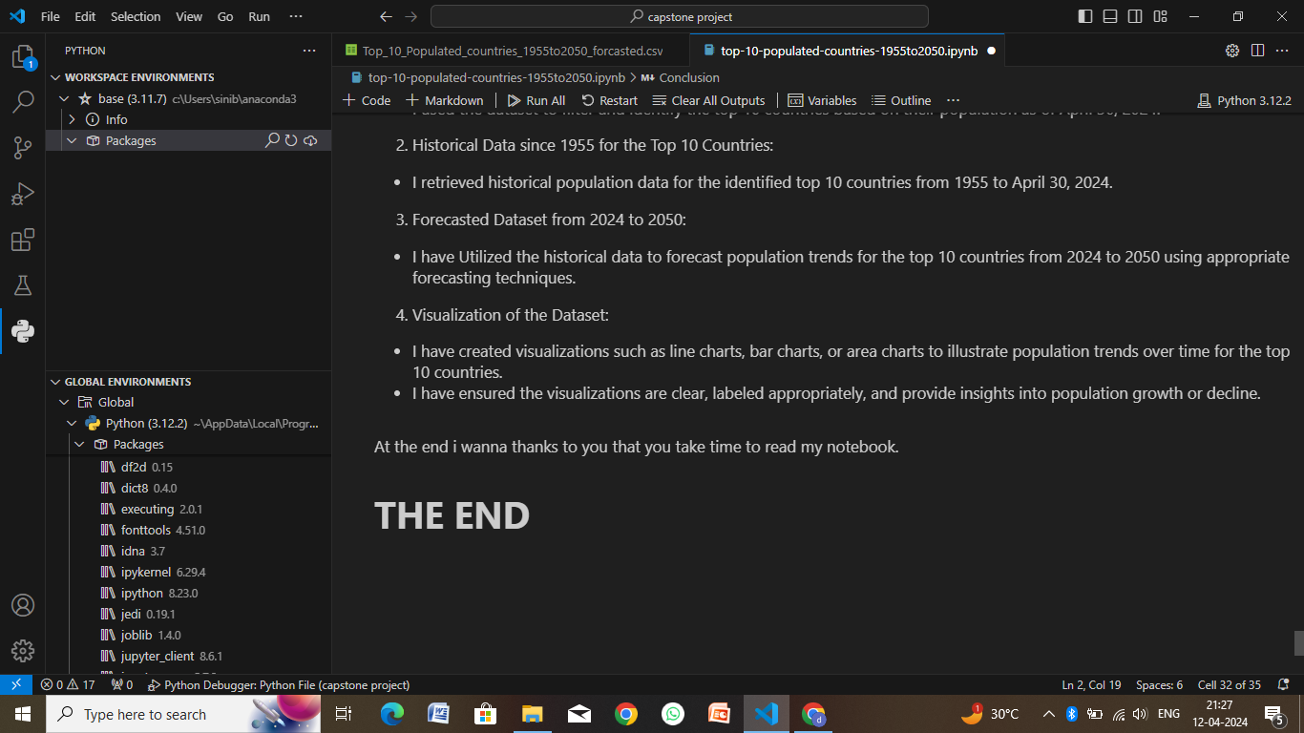

Slide 14
Conclusion
In conclusion, managing the top 10 most populated countries involves designing an algorithm that efficiently handles adding countries, updating the top 10 list, and performing population-related calculations. The algorithmic approach typically includes data structures for storing country-population pairs, functions for adding countries, updating the top 10 list, and calculating total and average populations.
For deployment, the algorithm can be integrated into a software application or deployed as a standalone service. Containerization using Docker can simplify deployment and management across different environments. Deployment platforms such as AWS, Azure, or Google Cloud can host the application, ensuring scalability, reliability, and security.
Overall, a well-designed algorithm combined with effective deployment strategies enables the management of top 10 populated countries, providing valuable insights into global population demographics and trends.

Slide 15
Future scope
The management of the top 10 most populated countries has several potential avenues for future development and enhancement:
Real-Time Data Updates: Implement mechanisms to fetch and update population data in real-time. This could involve integrating with APIs or databases that provide live population statistics.
Dynamic Ranking: Instead of a static top 10 list, create a system that dynamically ranks countries based on population changes over time. This could involve incorporating historical data and trend analysis algorithms.
Geospatial Visualization: Enhance the user experience by integrating geospatial visualization tools. Displaying population distributions on maps can provide a more intuitive understanding of global population trends.
Machine Learning Predictions: Utilize machine learning algorithms to predict future population trends based on historical data. This can be valuable for long-term planning and decision-making.
Multi-Source Data Integration: Expand data sources beyond population alone. Incorporate socio-economic indicators, healthcare statistics, and environmental factors to provide a holistic view of global demographics.
Customizable Analytics: Allow users to customize their analytics, such as selecting specific regions or demographic criteria for population analysis.
Mobile and Web Applications: Develop mobile apps or web-based dashboards for accessing and visualizing population data on various devices, making the information more accessible to a wider audience.
API for Integration: Provide an API for developers to integrate population data into their own applications, fostering innovation and the development of new tools and services.

Slide 16
References
United Nations, Department of Economic and Social Affairs (UN DESA):
The UN DESA provides comprehensive data and reports on global population trends, including the populations of individual countries.
World Population Review:
The World Population Review is a reliable source for population data, including rankings of countries by population.
National Statistical Offices:
Many countries' official statistical offices publish population data and reports that can be accessed through their respective websites.
Population Reference Bureau (PRB):
PRB is an organization that conducts research and analysis on population issues globally, offering data and reports on population trends.
Our World in Data:
Our World in Data is a reputable source for global statistics and offers population data along with interactive visualizations.
Government Websites:
Official government websites of countries often provide population statistics and demographic information, which can be reliable sources for data.

Slide 17
THANK YOU

